Slide 1
Event Management Website
Affan Asad Charolia - aacbb8@mail.umkc.edu
Aqdus Arshad Charolia – aacy5x@mail.umkc.edu
Priya Varsha Tarlapally – ptf2x@mail.umkc.edu

Slide 2
Issue
In the domain of event management, there are only two companies who provide a platform for the event hosts to approach both their clients and their sponsors. These are LinkedIn and Facebook, but where LinkedIn is good for finding sponsors it cannot be said the same for them helping find the clients and for Facebook it is opposite.

Slide 3
Proposed Idea
The idea is to create a platform in form of a website which will help organizers post their events. An individual who is looking for events can see the list. The events are categorized helping the user to select based on his choice. Along with events there will be a page where there will be a list of companies. The organizers can look for companies which can be a potential sponsor by sorting them based on their profile. They can contact them and share their profile to promote their event and get them as their sponsors. The sponsors can in turn get their name added to the event post and market themselves.

Slide 4
Technology used
Database: MongoDB
Front-end: HTML, CSS, JavaScript, NodeJS, React, Bootstrap
Back-end: ExpressJs, NodeJs

Slide 5
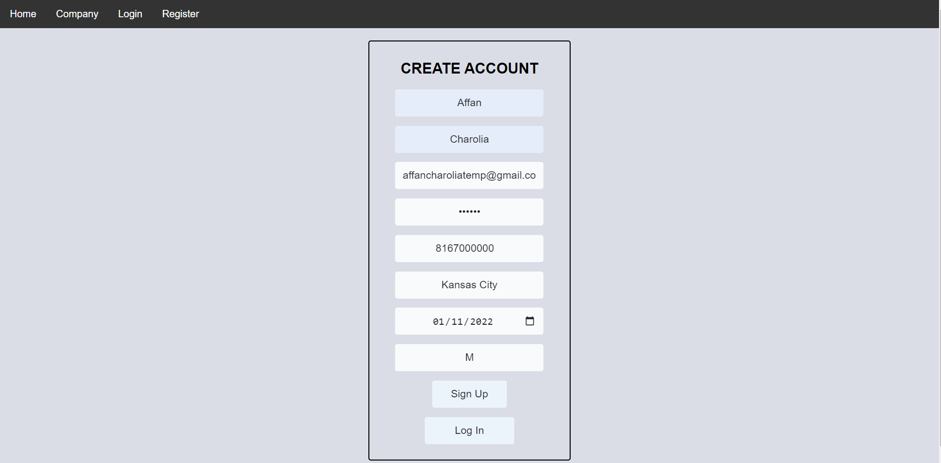
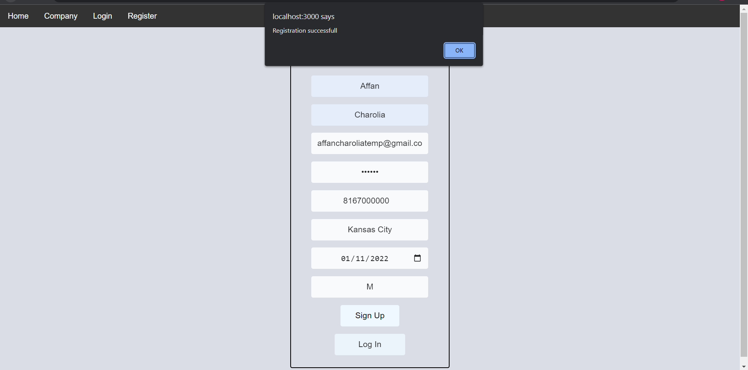
How it works
User has the option to register and Login. When not logged in they can see 4 tabs: For Home, Company, Login and Register. In the home page they can see all the events that are available and in the company page they can see the list of sponsors. Once logged in the system creates a token against the user which is used to store user information.

Slide 6
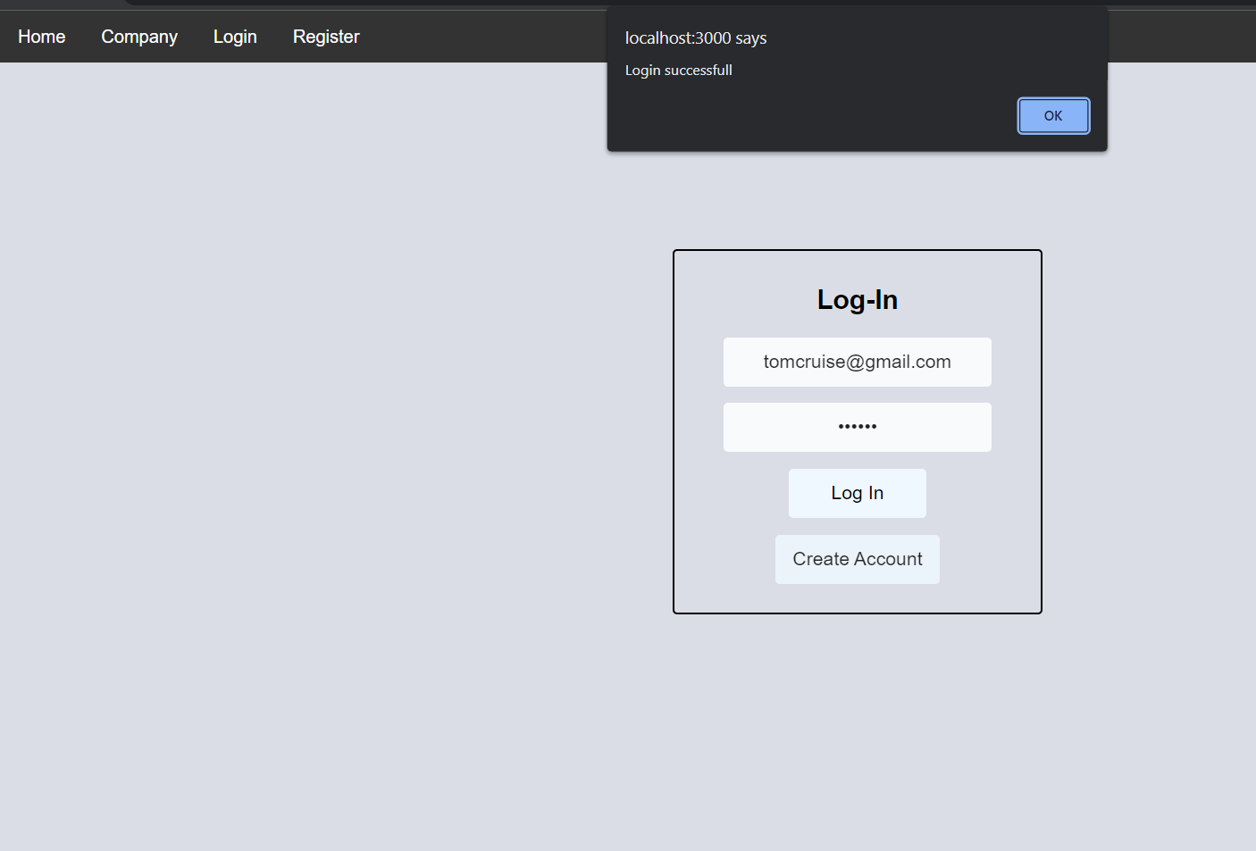
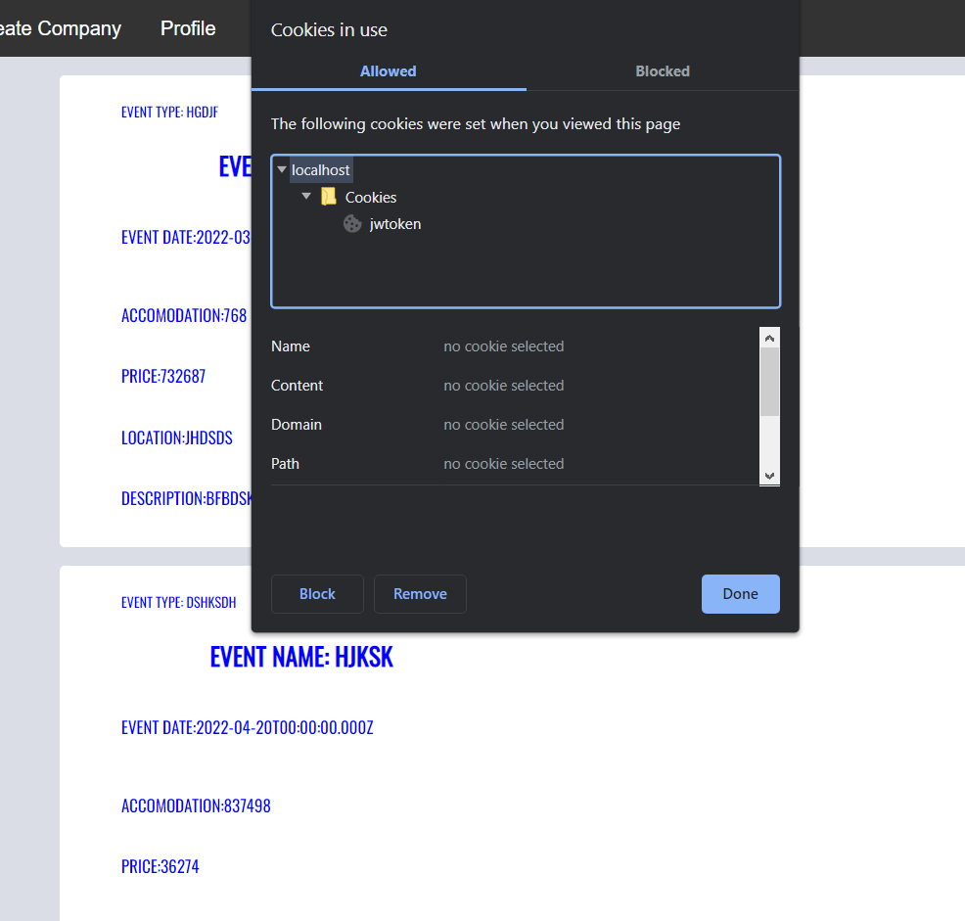
How it works

Slide 7
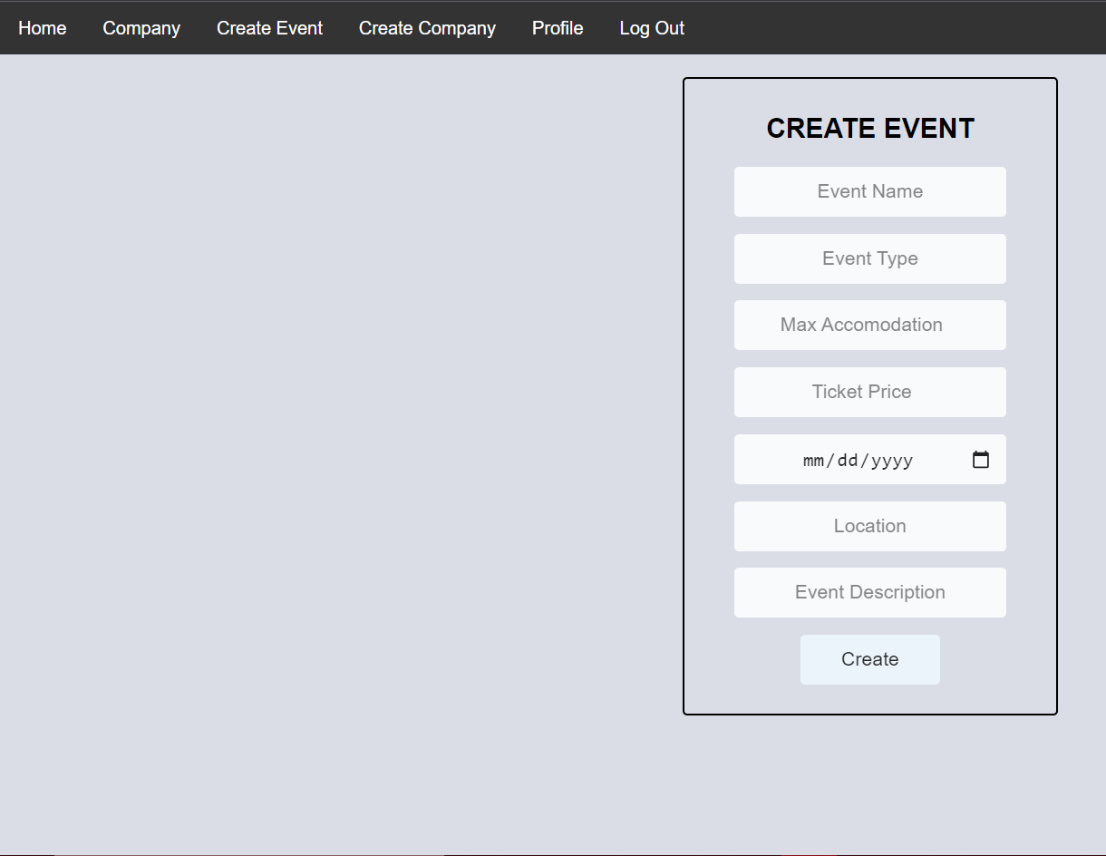
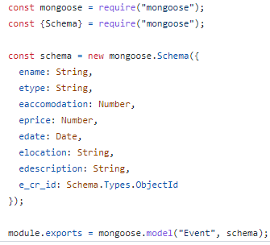
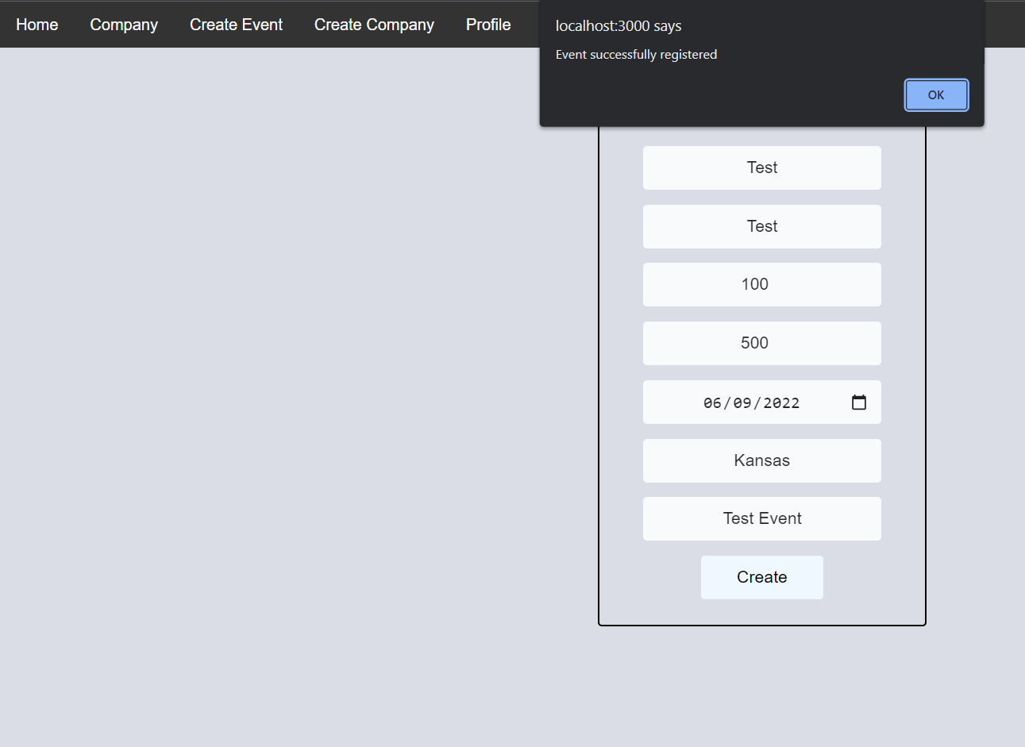
How it works
After getting logged in they can now see their profile, create event, create company and logout tabs. The user has the option to create a new company and an event, which when created gets registered against their profile.

Slide 8
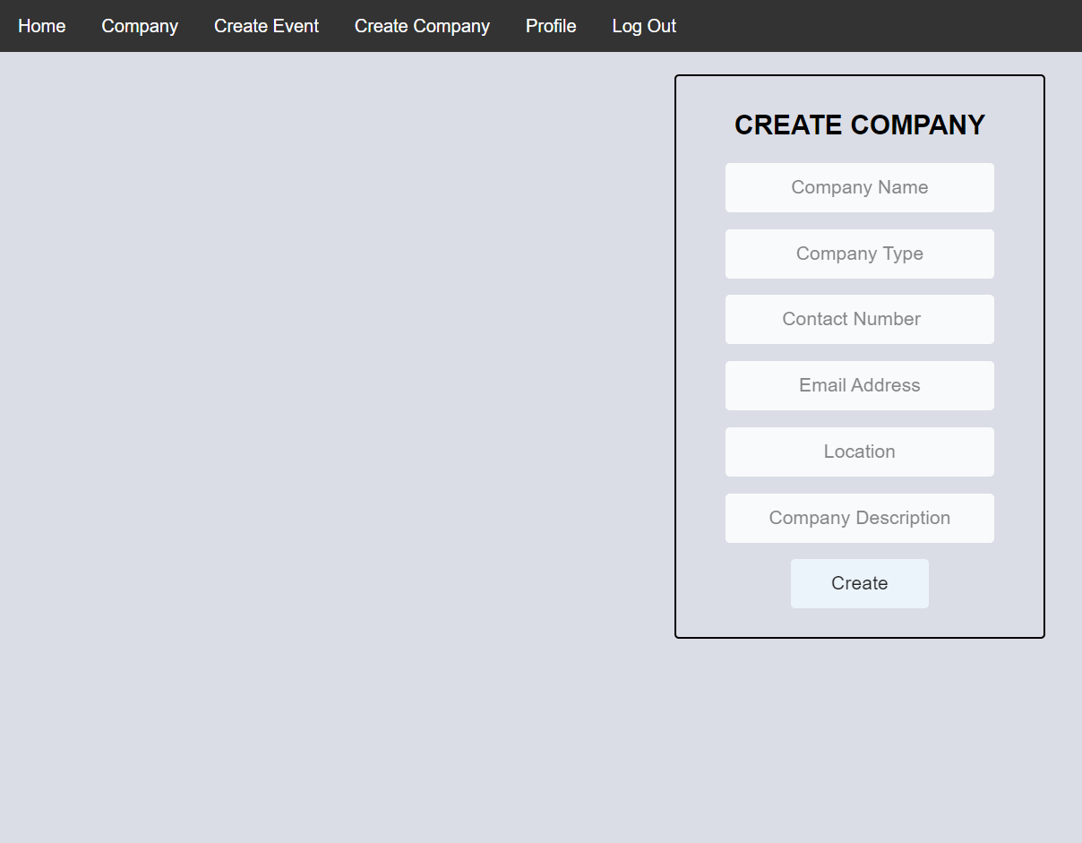
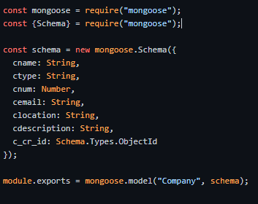
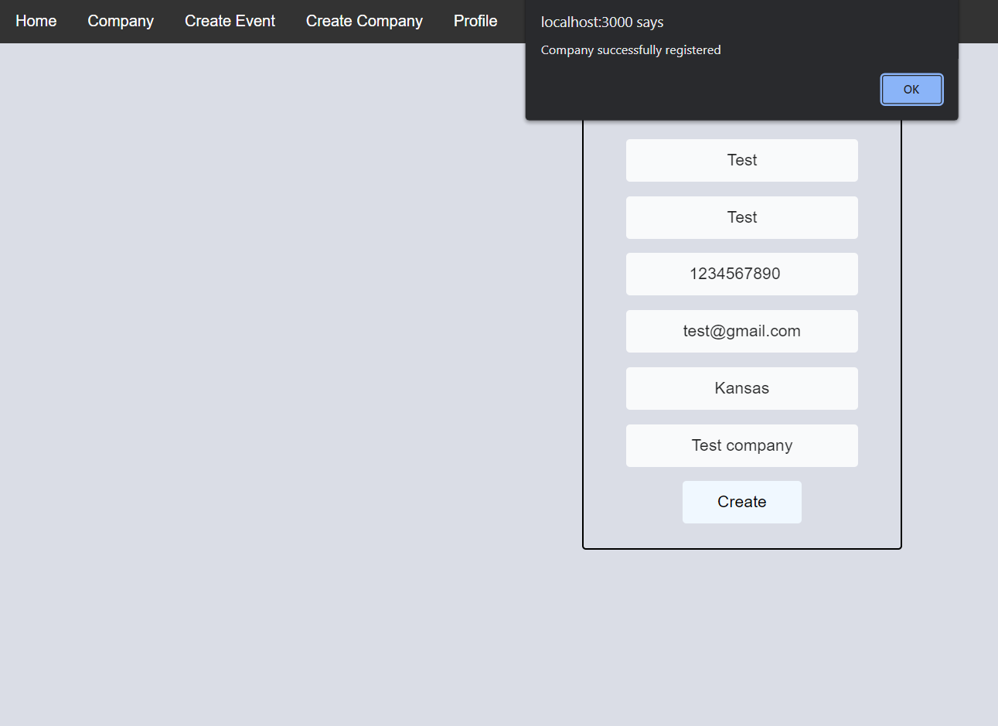
How it works

Slide 9
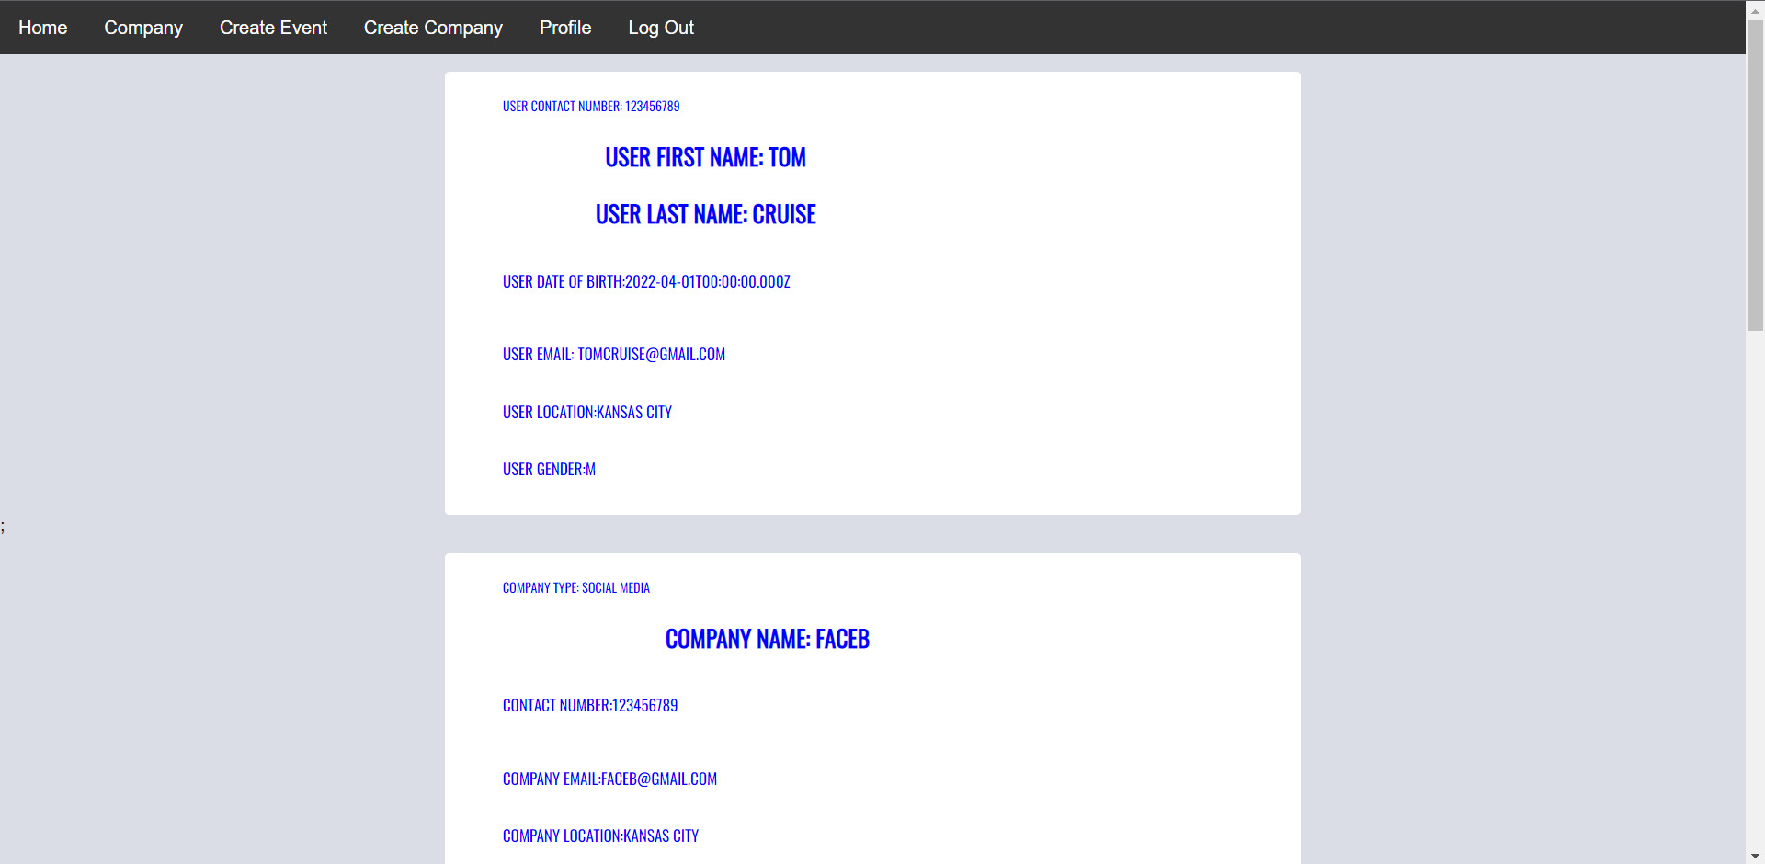
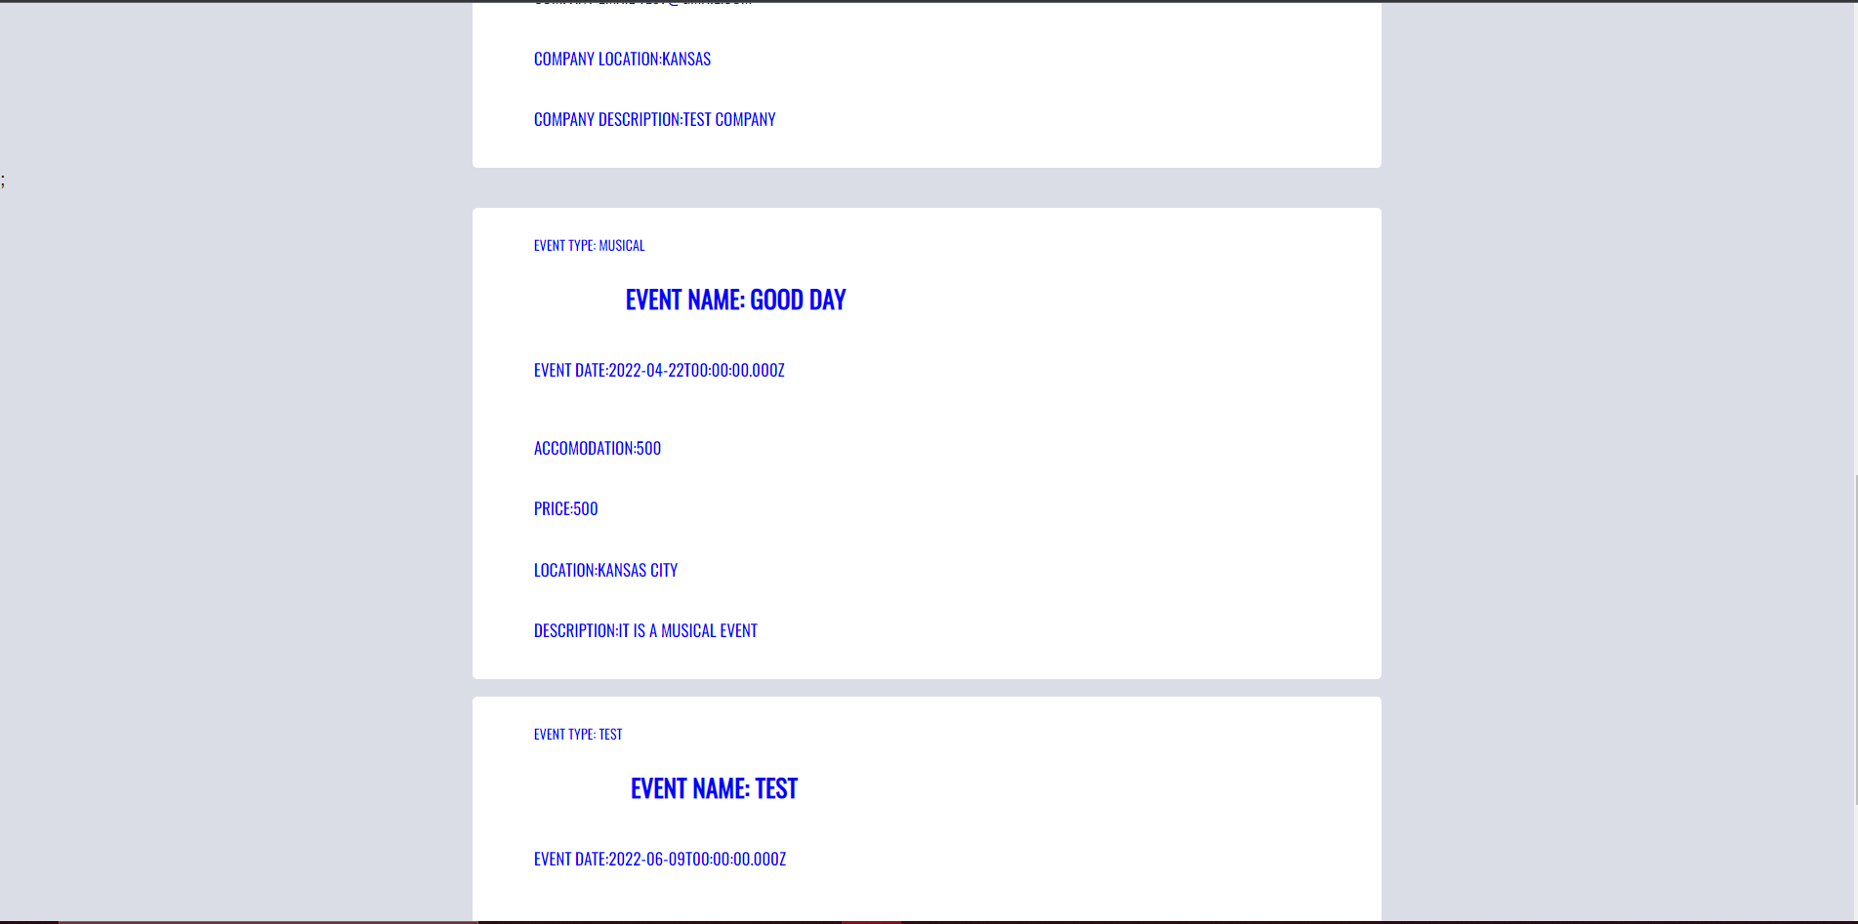
How it works
The user can see his created company and event in the home and company page sections. They are also added on against their profile. They can logout and then return to the login page where they started.

Slide 10
Future works
Linking the event block with the company page.
Adding the payment section.
Adding post section for event
Adding separate pages for individual companies and events.

Slide 11
Work distribution
• Affan- Designed the website interface, functionalities and backend database schema.
• Aqdus- Creating the express functionality to link backend with frontend.
• Priya- Creating the react application functionalities, CSS and bootstrap.

Slide 12
Thank You.

